Slide 1
Decision Process for Digital TV Adoption
Liliana García and András Lux

Slide 2
Introduction
Short overview of digital televison standards
Decisions in the World
Decision Factors
Closer look at South America
Conclusions

Slide 3





Digital Television Standards
Four competing standards
  DVB-T (European-centered)
  ATSC (USA)
  ISDB-T (Japan, DiBEG)
  DMB-T/H (China)
All significantly better than analogue
  For the public, state, suppliers
Some, but no critical differences between them

Slide 4

Decisions
Countries are adopting the standards
  Choice
Three groups of countries
  Developer countries
  Countries having a strong bias
  Countries with freedom of choice

Slide 5
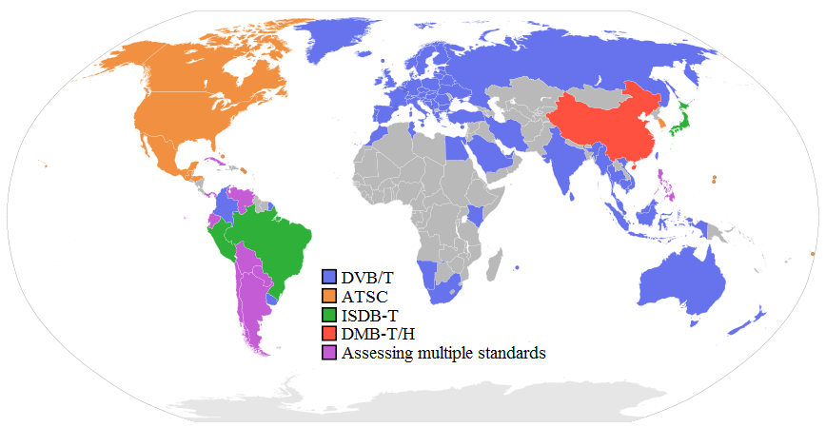
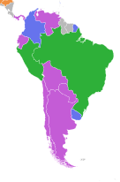
Current situation
Source: http://en.wikipedia.org/wiki/Digital_terrestrial_television, 2009-05-14

Slide 6
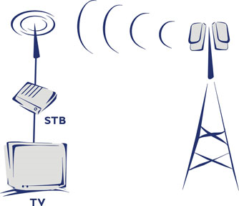



Decision Factors
Technical
Economical
Social
Political

Slide 7
Decision Factors
Technical
Efficient spectrum usage
Image & audio quality and services
Suitability for the country’s topography
Available video codec (MPEG-2, MPEG-4)

Slide 8
Decision Factors
Economical
Costs
  Users – e.g. price of receivers
  State – e.g. subsidization
  Industry – e.g. infrastructure, licensing
Benefits
  Costs
  Benefits

Slide 9
Decision Factors
Social
Present and future coverage
New content, services, new habits
Industrial development, economical growth, new opportunities

Slide 10
Decision Factors
Political
Technical cooperation, technology transfer
Workforce training
Scientific cooperation, R & D
Institutional cooperation

Slide 11
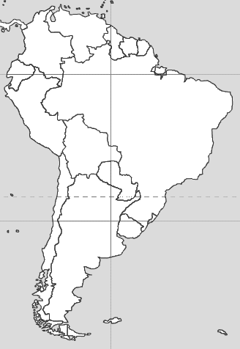
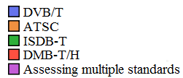
Closer look at South America
Brazil
Uruguay
Colombia
Peru
Rest is up for grabs

Slide 12
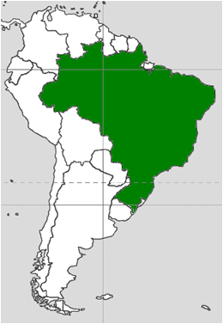
Closer look at South America
Brazil
Uruguay
Colombia
Peru
Rest is up for grabs
Jun 2006
A robust and flexible standard suitable for local conditions.
Establishment of manufacturing in Brazil
Brazil

Slide 13
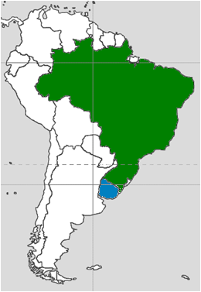
Closer look at South America
Brazil
Uruguay
Colombia
Peru
Rest is up for grabs
August 2007
Standard potentially boosts local software developing.
Standard that is already adopted by a large number of countries.
Strengthening economical ties with these countries.
Brazil

Slide 14
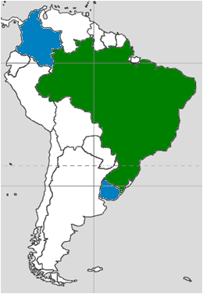
Closer look at South America
Brazil
Uruguay
Colombia
Peru
Rest is up for grabs
August 2008
Adopt a standard with lower costs for viewers.
DVB-T standard also contains a more advanced video coding algorithm, beneficial on the long run.
A widely adopted standard.
Brazil

Slide 15
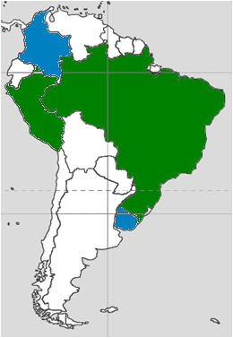
Closer look at South America
Brazil
Uruguay
Colombia
Peru
Rest is up for grabs
24 April 2009
Strengthening the country’s economical ties with Brazil and Japan.
Adoption of a standard with an extensive user base.
Brazil

Slide 16
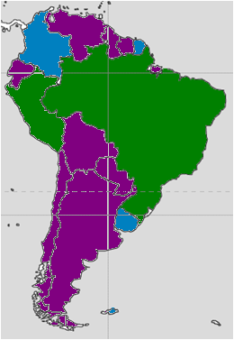

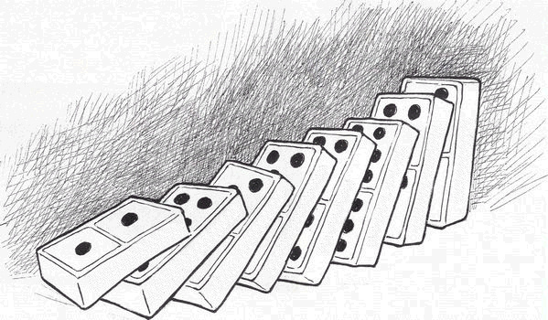
Closer look at South America
Brazil
Uruguay
Colombia
Peru
Rest is up for grabs
Brazil

Slide 17
Conclusions
Factors are weighted differently in each country
State – Companies – Users has different interests and different weight.
Our opinion:
  Current process is adequate
  More intercountry cooperation needed

Slide 18
Thank you for your attention!
We welcome your questions and comments!

